Slide 1


Dress Code Policy
Effective Date: January 5, 2024
Powered by

Slide 2
Content
Policy statement and scope
Policy elements
Uniform and Office wear guidelines
Dress Code Guidelines - Female Team Members
Approved dress for pregnant team members
Dress Code Guidelines - Male Team Members
Common appearance tips for both genders
Roles and Responsibilities & Disciplinary Consequences
Conclusion
Powered by

Slide 3
Policy Statement & Scope
The dress code policy at Lyceum Global Holdings outlines management's expectations for employee attire, promoting professionalism and appropriate grooming. It offers clear guidelines for both genders, with flexibility for maternity or related concerns.
Employee appearance significantly impacts first impressions and reflects the company's image. To maintain a positive company representation, all team members are expected to strictly adhere to this policy.
This dress code policy applies to all employees of Lyceum Global Holdings, regardless of their department or designation.
Powered by

Slide 4
Policy Elements
The collective term uniform refers to the approved attire by Lyceum Global Holdings management.
The collective term normal office wear refers to any form of clothing/ garment that has been approved by the management to be worn to office premises.
The acronym LGH refers to Lyceum Global Holdings (Private) Limited.
The acronym HRBP refers to human resource business partner
Powered by

Slide 5
Uniform and Office Wear Guidelines
Uniform Schedule
Mondays & Wednesdays: Approved uniform required.
Board Meetings & Special Occasions: Uniform must be worn.
Tuesdays & Thursdays: Normal office wear permitted.
Fridays: Dress-down with company T-shirts and office pants (no denim or deck shoes).
Newcomers - Employees Awaiting Uniform Provision
Males: White shirt with black/dark ash/dark blue trousers.
Females: White blouse with black/dark ash/dark blue trousers.
Review & Updates
Policy will be periodically reviewed for effectiveness and compliance.
Powered by

Slide 6
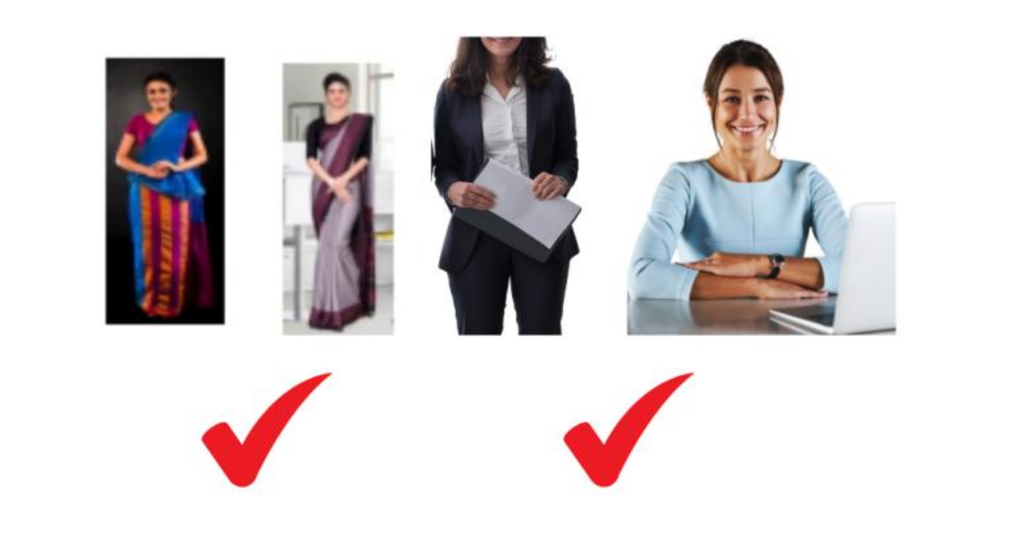
Dress Code Guidelines - Female Team Members
General Office Wear: Business or professional attire, including saree/Osari suitable for a professional setting.
Saree Guidelines: Jackets must have sleeves, conservative necklines, and culturally appropriate. Midriff region must also be conservative and appropriate for an official setting.
Prohibited Attire: No short skirts, mini skirts, party-related garment above the knee within the company premises during work hours, blue denim jeans, or workout clothing.
Dress-down Fridays & Events: Smart casual attire allowed, including the Lyceum company or 30th-anniversary short-sleeve shirt with a black / dark-colored pair of ladies' trousers, or the standard Kurtha from the Uniform Hub.
Powered by

Slide 7
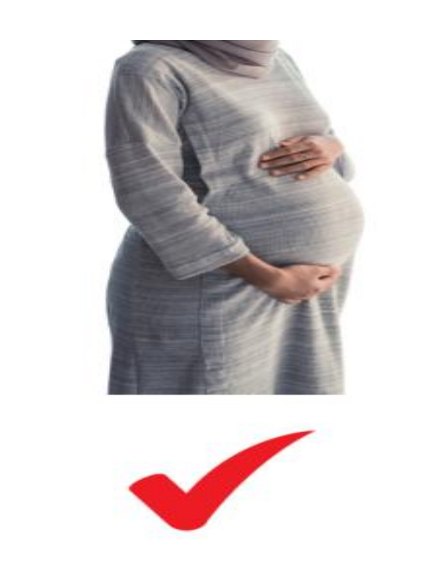
Approved dress for pregnant team members
Pregnant team members are permitted to wear appropriate maternity dresses during the commencement of their 3rd month of pregnancy.
Such members are advised to communicate with their HR business partner for any additional dress-related concerns that arise due to their medical complications but changes in the dress can only be implemented with the approval of the management.
Any form of pants or trousers worn must also be conservative. Gym pants and other modes of tight-fit leggings & sportswear are not permitted within the company premises or while representing the company outdoors, especially during work hours.
Powered by

Slide 8
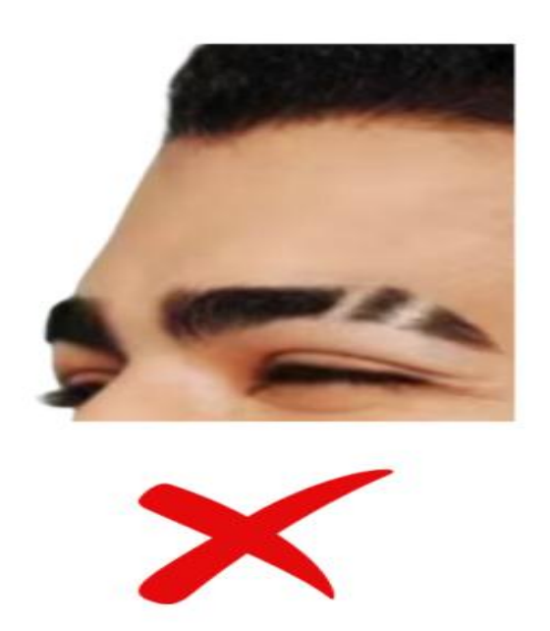
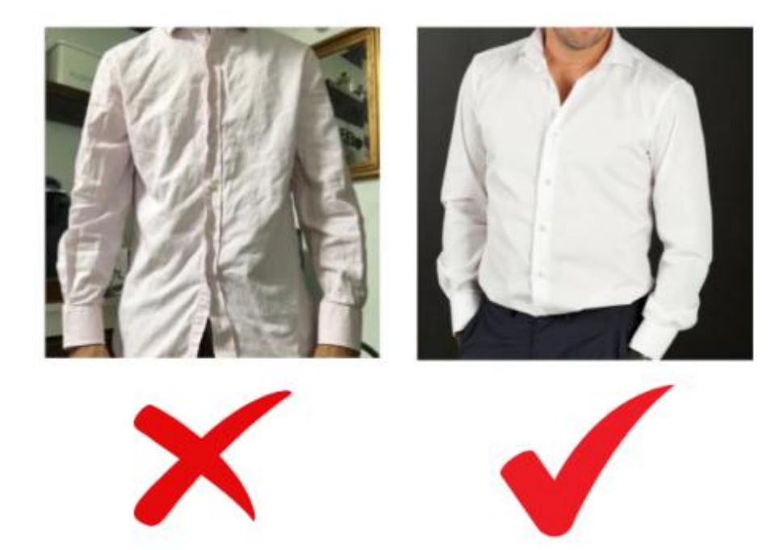
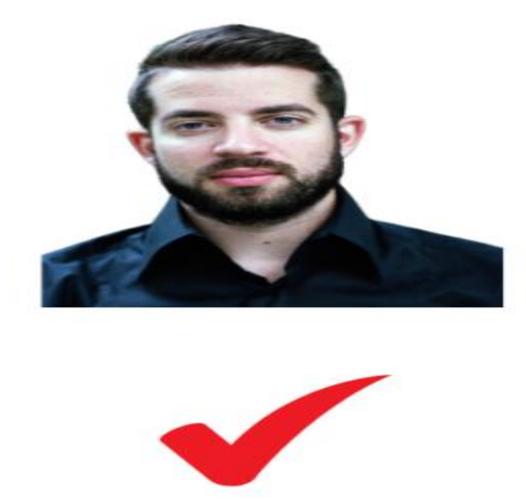
Dress Code Guidelines - Male Team Members
General Office Attire: Business or smart casual, long-sleeved plain shirts with collars, black belt, and black/similar color trousers.
Shirts & Accessories: Shirts must be tucked in; end of the belt must not be left hanging. Professional cufflinks and tie pins are allowed.
Prohibited: No collarless or short-sleeved shirts (except on dress-down Fridays with company T-shirts).
Grooming: Cleanly trimmed fingernails are mandatory; no growing fingernails.
Clothing & Appearance: Must be neat, clean, and ironed.
Beards: Clean-shaven or well-groomed beards are allowed.
Eyebrow Slits: Not allowed. Must be covered up
Powered by

Slide 9
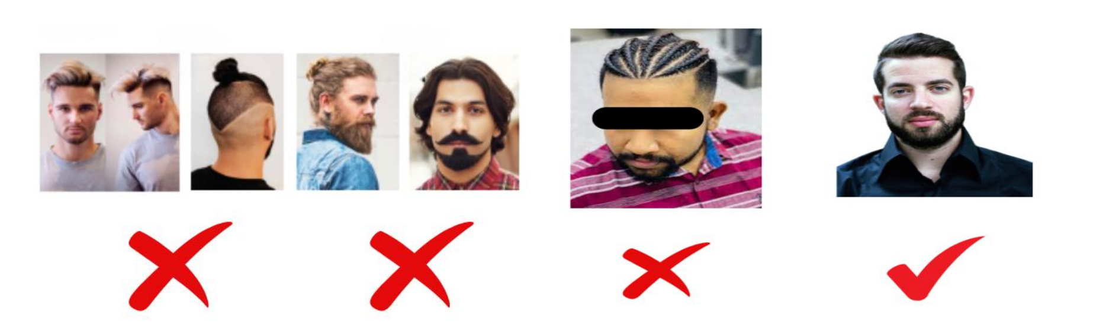
Common appearance tips for both genders
Hairstyles - Guidelines for Both Genders
Team members of both genders are advised to have well-groomed hair while at the office premises. Slightly tinted/colored hair with brown or black colors is acceptable for both genders.
Decent hairstyles appropriate for the company are permitted. Hair braids and unnatural hair colors are not allowed for either gender. In addition to the aforementioned points, male employees are not allowed to have hair buns.
Powered by

Slide 10
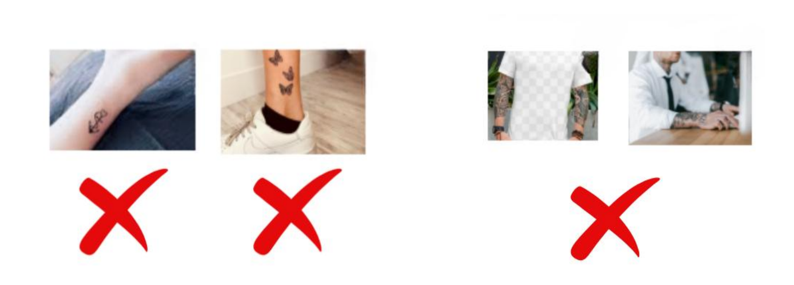
Common appearance tips for both genders
Visibility of tattoos & body paintings (Both genders)
All visible tattoos or body paintings must be covered while at company premises or when representing the company.
Tattoos on the neck, upper back, belly, arms, feet, ankles, and legs must be covered when wearing sarees/Osari or office wear.
Non-Compliance: Employees are advised to cover or remove such tattoos. Failure to comply will result in strict disciplinary action.
Powered by

Slide 11
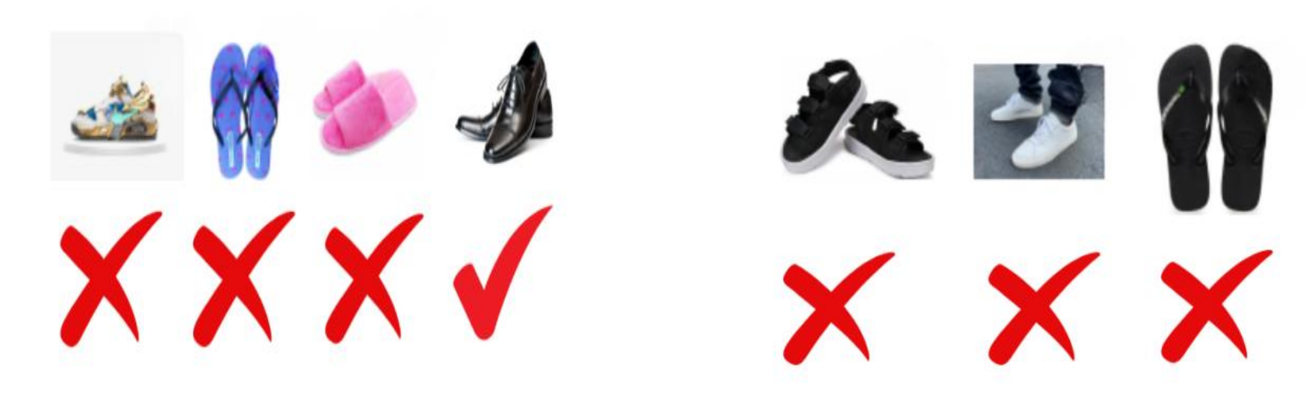
Common appearance tips for both genders
Footwear
While at the company premises or while representing the company elsewhere, all male employees are advised to wear office shoes. This includes black/brown color shoes with white/brown socks. Sandals and flip-flops are not permitted.
Female employees are permitted to wear appropriate footwear for a professional setting. However, flip-flops and sandals are not permitted.
Powered by

Slide 12
Roles and Responsibilities & Disciplinary Consequences
HRBP Responsibility:
Ensure all team members are aware of and adhere to the dress code policy, especially new employees.
Department Heads Responsibility:
Report non-compliance to the HR department.
Disciplinary Consequences
Non-compliance will result in up to 3 verbal or written warnings.
Further reluctance may lead to harsher consequences, including reprimand or termination.
Powered by

Slide 13
Conclusion
This policy will be periodically reviewed and updated to stay effective and aligned with organizational needs.
At Lyceum Global Holdings, maintaining a professional appearance reflects our commitment to excellence and upholding the values of our organization. We appreciate your adherence to the dress code policy, ensuring we represent our company with pride and professionalism.
Thank You!
Powered by

